Slide 1
Automata and Language Theory
DFA Minimization
Dr. Mohamed Nour

Slide 2
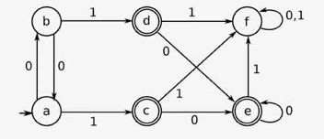
DFA Minimization using Equivalence Theorem
f
0,1
{a, b, f} {c, d, e}
1
0
0
a,b
1
c,d,e
Notes:
Eliminate all the dead states and inaccessible states from the given DFA (if any).
Dead State
All those non-final states which transit to itself for all input symbols in ∑ are called as dead states.
Inaccessible State
All those states which can never be reached from the initial state are called as inaccessible states.

Slide 3
DFA Minimization
f
0,1
{a, b, f} {c, d, e}
{a, b} {f} {c, d, e}
1
0
0
a,b
1
c,d,e

Slide 4
DFA Minimization
f
0,1
{a, b, f} {c, d, e}
{a, b} {f} {c, d, e}
{a, b} {f} {c, d, e}
1
0
0
a,b
1
c,d,e

Slide 5
Example:
Letter,digit
A
letter
B
letter
D
digit
digit
C
E
q | δ(q,letter) | δ(q,digit)
A | B | C
B | D | E
C | C | C
D | D | D
E | E | E
Letter,digit
Letter,digit

Slide 6
DFA Minimization
{A, C} {B, D, E}
{A} {C} {B, D, E}
{A} {C} {B, D, E}
Letter,digit
A
letter
B,D,E
digit
q | δ(q,letter) | δ(q,digit)
A | B | C
B | D | E
C | C | C
D | D | D
E | E | E
C
Letter,digit

Slide 7
Example 2
Minimize the following DFA
a
a
q₁
b
q₃
a
q₀
a
a
b
b
q₂
q₄
b
b

Slide 8
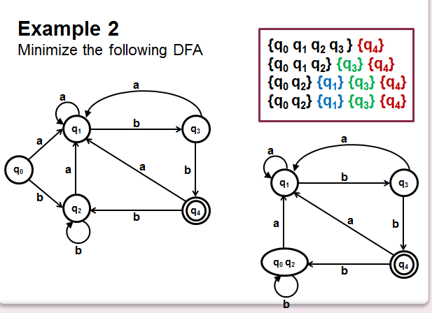

Slide 9
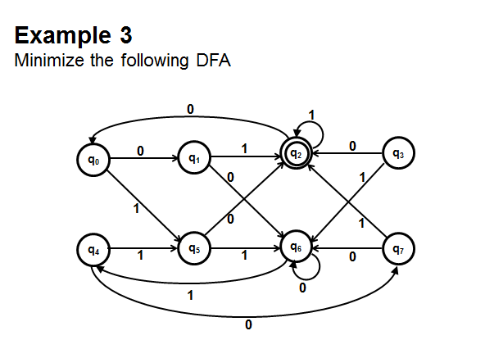

Slide 10
